Slide 1

Covid Care 360
Team : Skanda Srinivasan : 001582653
Kulbir Singh : 001548318
Rochak Nath : 001563060

Slide 2

Content
Problem Domain
Proposed Solution
Object Model
Key Features
Screenshot

Slide 3
Problem Domain
Our Problem domain is the ever growing burden on individual health care system, due to the COVID-19 Pandemic. State-wide networks of medical services are rapidly being stretched thin due to a lack of a centralized system for a global pandemic of unprecedented scope and duration.
A dedicated control organization for managing and monitoring Covid outbreaks and setting up robust contact tracing protocols is needed to take the burden off the overloaded healthcare network.

Slide 4
Proposed Solution
The solution is to do a proper separation of concerns at the state-level and corral Medical institutions, specialized healthcare personnel, the general population and safeguard/analytical organizations like the contact tracing organizations and the state covid statistics organizations into one cohesive solution.
Our solution aims to do this by bringing together organizations that normally only have a tentative link , and creating a efficient supply chain dynamic that will reduce overhead in time and resources spent on the over-burdened healthcare networks.

Slide 5
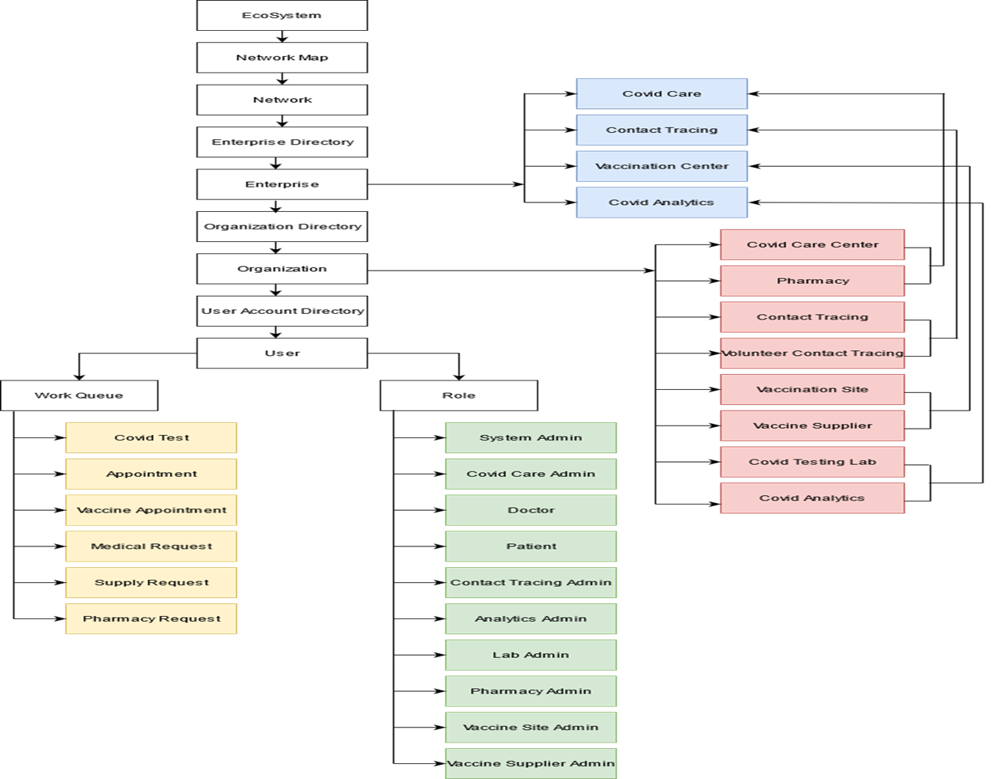
UML Model

Slide 6
Key Features
Location tracking leveraging Google Maps
Automated Email Alert Systems
Dedicated Analytics Organizations

Slide 7
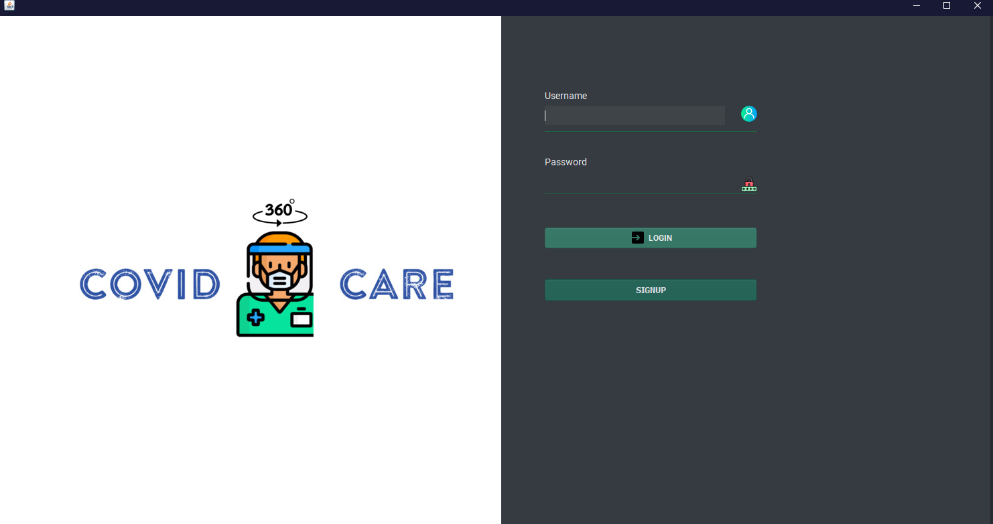
LOGIN PANEL

Slide 8
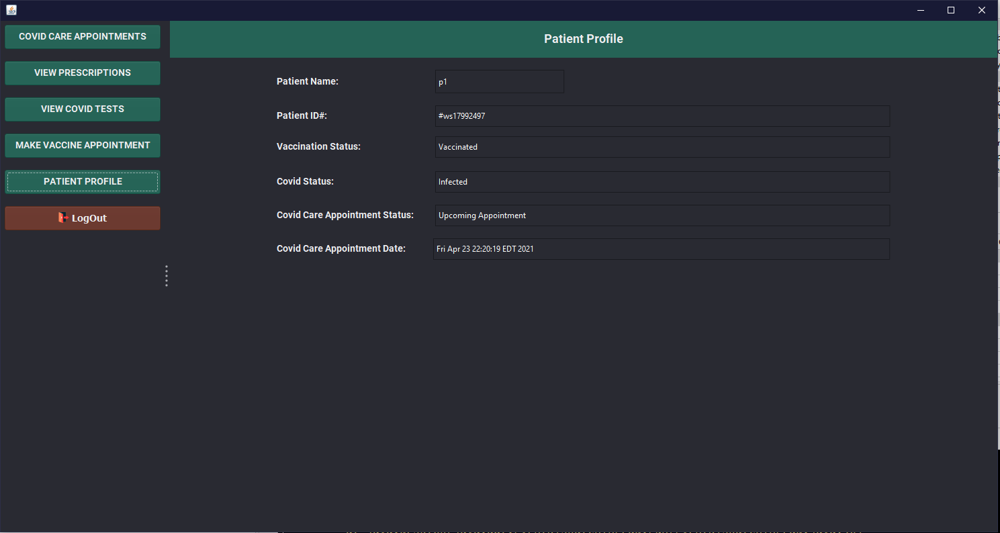
Patient work area

Slide 9
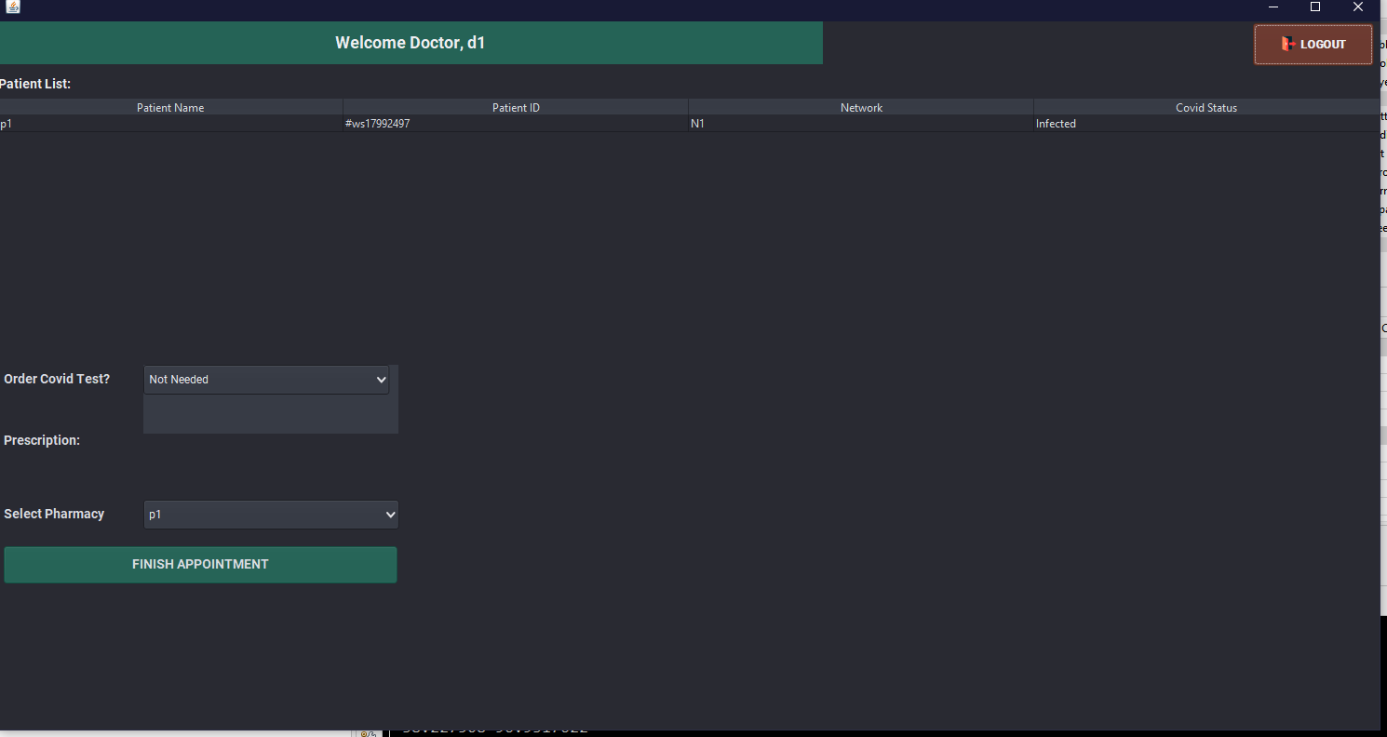
DOCTOR WORK AREA

Slide 10
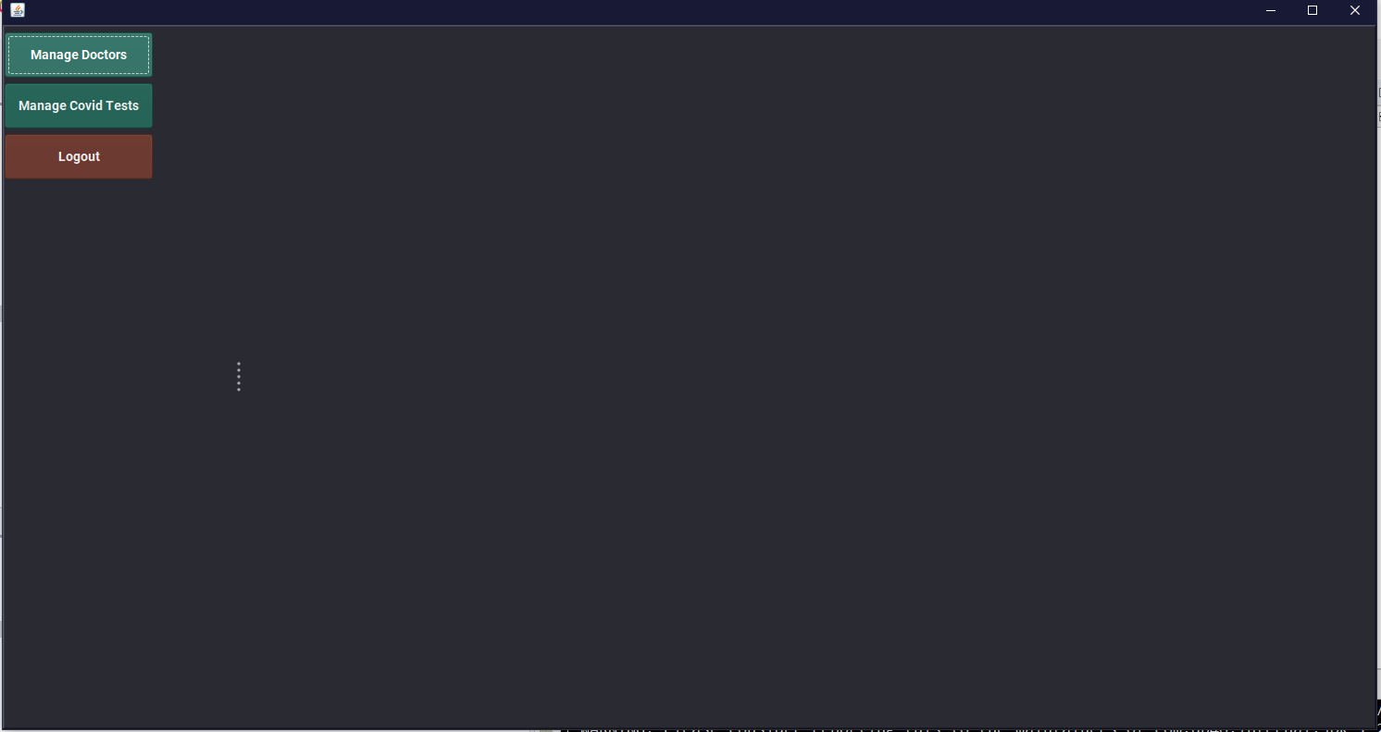
COVID CARE CENTER

Slide 11

Thank You

